Slide 1
Movie Booking Application
FSE – 1 Accreditation – Java – Angular - Aws
Manmohan Saraswat
Employee Id: 2113071

Slide 2
Tools & Technology Used:
Core Java(Language)
Spring Boot(Framework used for backend development)
MySQL(database)
Postman(for checking api working status)
Spring tool suite(IDE used for development)
Junit(for testing backend)
Jacoco(for code coverage)

Slide 3
Tables used in the database:
Movie(To store the information about the movie)
User (To store the details of the user)
Role (Role of user(Admin, User))
Tickets (Store details about the booked tickets)

Slide 4
API EndPoints
Register new User(Post Mapping)
Login User (Post Mapping)
Get All movie (Get Mapping)
Add Movie Ticket (Post Mapping)
Update Ticket Status (Put Mapping)
Search Movie by Name (Get Mapping)
Delete Movie (Delete Mapping)
Forgot Password (Post Mapping)

Slide 5
Movie Booking Application – Frontend FSE – 1 Accreditation – Java – Angular - Aws Manmohan Saraswat Employee Id: 2113071

Slide 6
Tools & Technology Used:
Node JS (Version: 18.16.)
Angular(Version: 16.0.1)
Angular Material(Version: 16.0.1)
Web browser(Chrome)
Vs Code(IDE Used for development)
NGX – COOKIE – SERVICE (for storing the user information)
NG – ANGULAR – POPUP (for showing the information using popup)
Jasmine and Karma (for angular component and service testing)

Slide 7
Component & Services used in application
Login Component ( For Signing in of user)
Register Component ( For Registering of user)
Forgot Password Component (For Resetting of user password)
Dashboard Component (For showing the movies information in UI)
Dialog( For confirmation and input of data from user)
API Service (For all api calls)

Slide 8
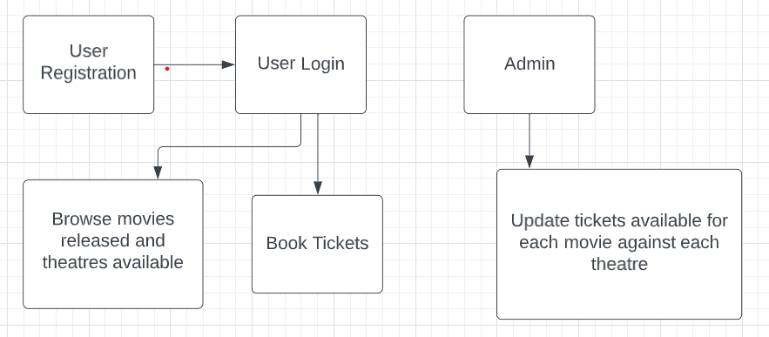
Flow Chart of the Frontend-Application

Slide 9
API EndPoints
Register new User(Post Mapping)
Login User (Post Mapping)
Get All movie (Get Mapping)
Add Movie Ticket (Post Mapping)
Update Ticket Status (Put Mapping)
Search Movie by Name (Get Mapping)
Add Movie (Post Mapping)
Forgot Password (Post Mapping)

Slide 10
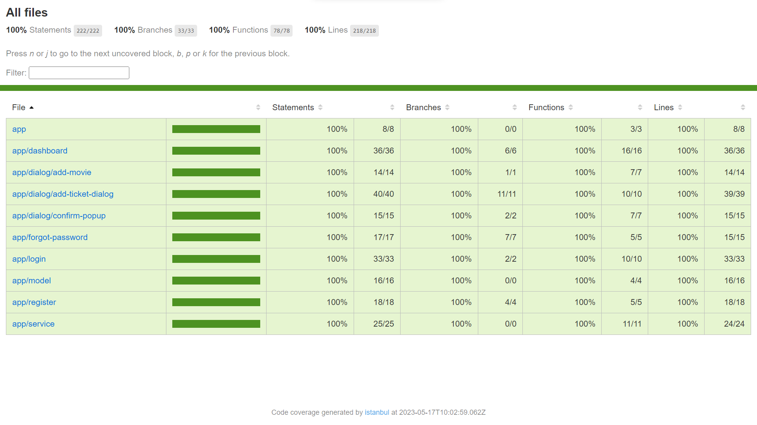
Unit testing and Code coverage

Slide 11
Thank You

